Slide 1
Graphs

Slide 2
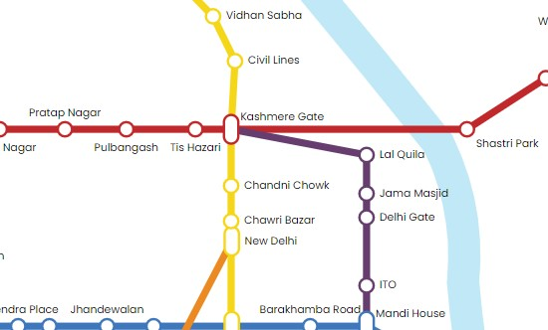
Definitions - Graph
A generalization of the simple concept of a set of dots, links, edges or arcs.
Representation: Graph G =(V, E) consists set of vertices denoted by V, or by V(G) and set of edges E, or E(G)

Slide 3
Definitions – Edge Type
Directed: Ordered pair of vertices. Represented as (u, v) directed from vertex u to v.
Undirected: Unordered pair of vertices. Represented as {u, v}. Disregards any sense of direction and treats both end vertices interchangeably.
u
v
u
v

Slide 4
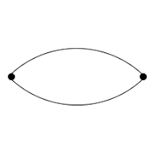
Definitions – Edge Type
Loop: A loop is an edge whose endpoints are equal i.e., an edge joining a vertex to it self is called a loop. Represented as {u, u} = {u}
Multiple Edges: Two or more edges joining the same pair of vertices.
u

Slide 5
Definitions – Graph Type
Simple (Undirected) Graph: consists of V, a nonempty set of vertices, and E, a set of unordered pairs of distinct elements of V called edges (undirected)
Representation Example: G(V, E), V = {u, v, w}, E = {{u, v}, {v, w}, {u, w}}
u
v
w

Slide 6
Definitions – Graph Type
Multigraph: G(V,E), consists of set of vertices V, set of Edges E and a function f from E to {{u, v}| u, v ∈ V, u ≠ v}. The edges e1 and e2 are called multiple or parallel edges if f (e1) = f (e2).
Representation Example: V = {u, v, w}, E = {e₁, e₂, e₃}
u
e₁
e₂
w
v
e₃

Slide 7
Definitions – Graph Type
Pseudograph: G(V,E), consists of set of vertices V, set of Edges E and a function F from E to {{u, v}| u, v Î V}. Loops allowed in such a graph.
Representation Example: V = {u, v, w}, E = {e₁, e₂, e₃, e₄}
A pseudograph is a graph in which loops (edges that connect a vertex to itself) and multiple edges (more than one edge connecting two vertices) can exist. A simple graph, on the other hand, does not support loops or numerous edges.
u
e₁
w
e₄
e₂
v
e₃

Slide 8
Different Types of Graphs
https://www.geeksforgeeks.org/graph-types-and-applications/

Slide 9
Definitions – Graph Type
Directed Graph: G(V, E), set of vertices V, and set of Edges E, that are ordered pair of elements of V (directed edges)
Representation Example: G(V, E), V = {u, v, w}, E = {(u, v), (v, w), (w, u)}
u
v
w

Slide 10
Definitions – Graph Type
Directed Multigraph: G(V,E), consists of set of vertices V, set of Edges E and a function f from E to {{u, v}| u, v ∈ V}. The edges e1 and e2 are multiple edges if f(e1) = f(e2)
Representation Example: V = {u, v, w}, E = {e₁, e₂, e₃}
u
w
e₁
e₂
v
e₃

Slide 11
Definitions – Graph Type
Directed Pseudograph: G(V,E), consists of set of vertices V, set of Edges E and a function f from E to {{u, v}| u, v ∈ V}. The edges e1 and e2 are multiple edges if f(e1) = f(e2)
Representation Example: V = {u, v, w}, E = {e₁, e₂, e₃, e₄}
u
w
e₄
e₁
e₂
v
e₃

Slide 12
Definitions – Graph Type
Type | Edges | Multiple Edges Allowed ? | Loops Allowed ?
Simple Graph | undirected | No | No
Multigraph | undirected | Yes | No
Pseudograph | undirected | Yes | Yes
Simple Directed Graph | directed | No | No
Directed Multigraph | directed | Yes | No
Directed Pseudograph | directed | Yes | Yes

Slide 13
Terminology – Undirected graphs
u and v are adjacent if {u, v} is an edge, e is called incident with u and v. u and v are called endpoints of {u, v}
Degree of Vertex: the number of edges incident on a vertex. A loop contributes twice to the degree.
Pendant Vertex: deg (v) =1
Isolated Vertex: deg (k) = 0
Representation Example: For V = {u, v, w, k} , E = { {u, w}, {u, v} }, deg (u) = 2, deg (v) = 1, deg (w) = 1, deg (k) = 0, w and v are pendant , k is isolated
u
v
k
w

Slide 14
Terminology – Directed graphs
For the edge (u, v), u is adjacent to v OR v is adjacent from u, u – Initial vertex, v – Terminal vertex
In-degree (deg⁻ (u)): number of edges for which u is terminal vertex
Out-degree (deg⁺ (u)): number of edges for which u is initial vertex
Note: A loop contributes 1 to both in-degree and out-degree
Representation Example: For V = {u, v, w} , E = { (u, w), ( v, w), (u, v) }, deg⁻ (u) = 0, deg⁺ (u) = 2, deg⁻ (v) = 1,
deg⁺ (v) = 1, and deg⁻ (w) = 2, deg⁺ (w) = 0
u
v
w

Slide 15
Simple graphs – special cases
Complete graph: K_{n}, is the simple graph that contains exactly one edge between each pair of distinct vertices.
Representation Example: K₁, K₂, K₃, K₄
K₁
K₂
K₃
K₄

Slide 16
Simple graphs – special cases
Cycle: C_{n}, n ≥ 3 consists of n vertices v₁, v₂, v₃ … v_{n} and edges {v₁, v₂}, {v₂, v₃}, {v₃, v₄} … {v_{n-1}, v_{n}}, {v_{n}, v₁}
Representation Example: C₃, C₄
C₃
C₄

Slide 17
Subgraphs
A subgraph of a graph G = (V, E) is a graph H =(V’, E’) where V’ is a subset of V and E’ is a subset of E
Application example: solving sub-problems within a graph
Representation example: V = {u, v, w}, E = ({u, v}, {v, w}, {w, u}}, H₁ , H₂
u
u
u
v
w
v
w
v
G
H₁
H₂

Slide 18
Subgraphs
G = G1 U G2 wherein E = E1 U E2 and V = V1 U V2, G, G1 and G2 are simple graphs of G
Representation example: V1 = {u, w}, E1 = {{u, w}}, V2 = {w, v},
E2 = {{w, v}}, V = {u, v ,w}, E = {{{u, w}, {{w, v}}
u
u
w
v
w
w
v
G1
G2
G

Slide 19
Advantages of graphs:
Graphs can be used to model and analyze complex systems and relationships.
They are useful for visualizing and understanding data.
Graph algorithms are widely used in computer science and other fields, such as social network analysis, logistics, and transportation.
Disadvantages of graphs:
Large graphs can be difficult to visualize and analyze.
Graph algorithms can be computationally expensive, especially for large graphs.

Slide 20
Representation
Incidence (Matrix): Most useful when information about edges is more desirable than information about vertices.
Adjacency (Matrix/List): Most useful when information about the vertices is more desirable than information about the edges. These two representations are also most popular since information about the vertices is often more desirable than edges in most applications.

Slide 21
Representation- Incidence Matrix
G = (V, E) be an undirected graph. Suppose that v₁, v₂, v₃, …, v_{n} are the vertices and e₁, e₂, …, e_{m} are the edges of G. Then the incidence matrix with respect to this ordering of V and E is the nx m matrix M = [m _{ij}], where
Can also be used to represent :
Multiple edges: by using columns with identical entries, since these edges are incident with the same pair of vertices
Loops: by using a column with exactly one entry equal to 1, corresponding to the vertex that is incident with the loop

Slide 22
Representation- Incidence Matrix
Representation Example: G = (V, E)
 | e₁ | e₂ | e₃
v | 1 | 0 | 1
u | 1 | 1 | 0
w | 0 | 1 | 1
u
e1
e2
v
w
e3

Slide 23
Representation- Incidence Matrix
 | e₁ | e₂ | e₃
a | 1 | 0 | 0
b | 1 | 1 | 0
c | 0 | 1 | 1
d | 0 | 0 | 1
e | 0 | 0 | 0
f | 0 | 0 | 0
e4 | e₅ | e₆ | e₇
0 | 0 | 0 | 1
0 | 0 | 0 | 0
0 | 1 | 1 | 0
1 | 0 | 0 | 0
1 | 1 | 0 | 0
0 | 0 | 1 | 1
e1
a
b
e7
e2
e3
f
c
d
e6
e5
e
e4

Slide 24
Representation- Adjacency Matrix
There is an N x N matrix, where |V| = N , the Adjacenct Matrix (NxN) A = [a_{ij}]
For undirected graph
For directed graph

Slide 25
Representation- Adjacency Matrix
The adjacency matrix of simple undirected graphs are symmetric (a_{ij} = a_{ji}) (why?)
When there are relatively few edges in the graph the adjacency matrix is a sparse matrix
Directed Multigraphs can be represented by using aij = number of edges from v_{i} to v_{j}

Slide 26
Representation- Adjacency Matrix
Example: Undirected Graph G (V, E)
 | v | u | w
v | 0 | 1 | 1
u | 1 | 0 | 1
w | 1 | 1 | 0
u
v
w

Slide 27
Representation- Adjacency Matrix
Example: directed Graph G (V, E)
 | v | u | w
v | 0 | 1 | 0
u | 0 | 0 | 1
w | 1 | 0 | 0
u
v
w

Slide 28
Representation- Adjacency List
Each node (vertex) has a list of which nodes (vertex) it is adjacent
Example: undirectd graph G (V, E)
u
node | Adjacency List
u | v , w
v | w, u
w | u , v
v
w

Slide 29
Connectivity
Basic Idea: In a Graph Reachability among vertices by traversing the edges
Application Example:
- In a city to city road-network, if one city can be reached from another city.
- Problems if determining whether a message can be sent between two computer using intermediate links
- Efficiently planning routes for data delivery in the Internet

Slide 30
Connectivity – Path
A Path is a sequence of edges that begins at a vertex of a graph and travels along edges of the graph, always connecting pairs of adjacent vertices.
Representation example: G = (V, E), Path P represented, from u to v is {{u, 1}, {1, 4}, {4, 5}, {5, v}}
2
1
v
3
u
4
5

Slide 31
Connectivity – Path
A Path of length n (> 0) from u to v in G is a sequence of n edges e₁, e₂ , e₃, …, e_{n} of G such that f (e₁) = (x_{o}, x₁), f (e₂) = (x₁, x₂₎, …, f (e_{n}) = (x_{n-1}, x_{n)}, where x₀ = u and x_{n} = v. A path is said to pass through x₀, x₁, …, x_{n} or traverse e₁, e₂ , e₃, …, e_{n}
For Simple Graphs, sequence is x₀, x₁, …, x_{n}
Circuit/Cycle: u = v, length of path > 0
Simple Path: does not contain an edge more than once

Slide 32
Connectivity – Connectedness
Articulation Point (Cut vertex): removal of a vertex produces a subgraph with more connected components than in the original graph. The removal of a cut vertex from a connected graph produces a graph that is not connected
Cut Edge: An edge whose removal produces a subgraph with more connected components than in the original graph.
Representation example: G (V, E), v₃ is the articulation point or edge {v₂, v₃}, the number of connected components is 2 (> 1)
v₃
v₅
v₁
v₂
v₄

Slide 33
Connectivity – Connectedness
Strongly, Unilaterally or Weakly connected Graphs
https://www.geeksforgeeks.org/check-if-a-graph-is-strongly-unilaterally-or-weakly-connected/

Slide 34
Graph Traversal Techniques
The previous connectivity problem, as well as many other graph problems, can be solved using graph traversal techniques
There are two standard graph traversal techniques:
Depth-First Search (DFS)—uses stack
Breadth-First Search (BFS)– uses queue

Slide 35
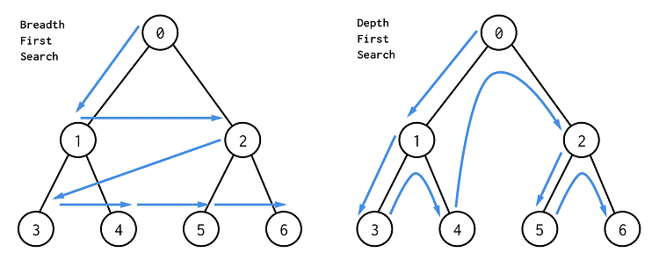

Slide 36
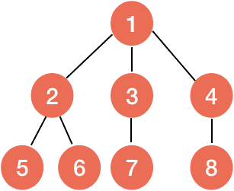
Breadth First Search
In BFS, we first visit all the nodes at the same depth first and then proceed visiting nodes at a deeper depth
For example, in the graph given below, we would first visit the node 1, and then after visiting the nodes 2, 3 and 4, we can proceed to visit any deeper node i.e., nodes 5, 6, 7 and 8

Slide 37
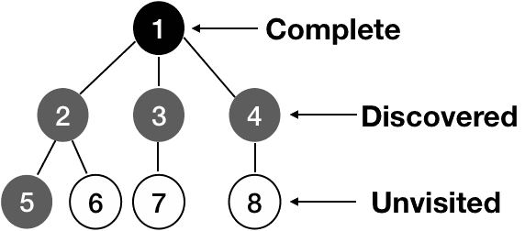
Breadth First Search
Example: three different colors i.e., white, gray and black are used to represent unvisited, discovered and complete respectively

Slide 38
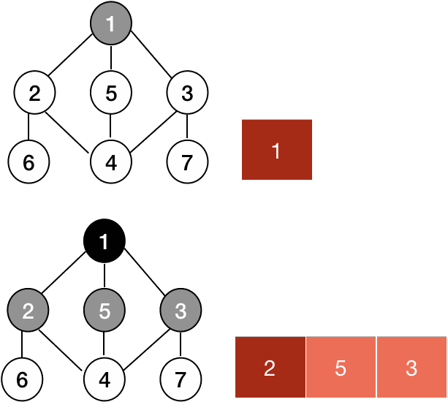
BFS
https://www.geeksforgeeks.org/breadth-first-search-or-bfs-for-a-graph/

Slide 39
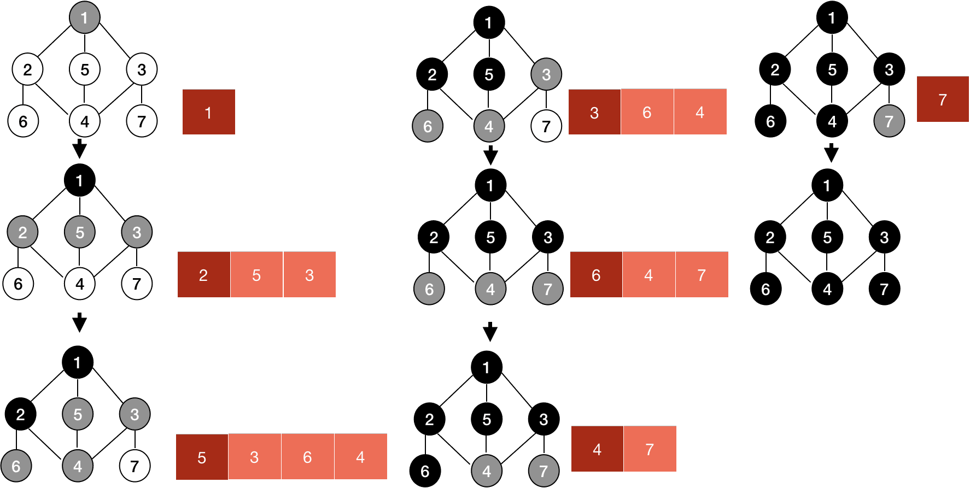
BFS

Slide 40
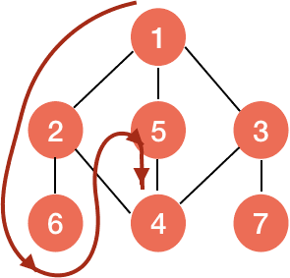
Depth First Search
DFS explores the depth of the graph before the breadth i.e., it traverses along the increasing depth and upon reaching the end, it backtracks to the node from which it was started and then do the same with the sibling node.

Slide 41
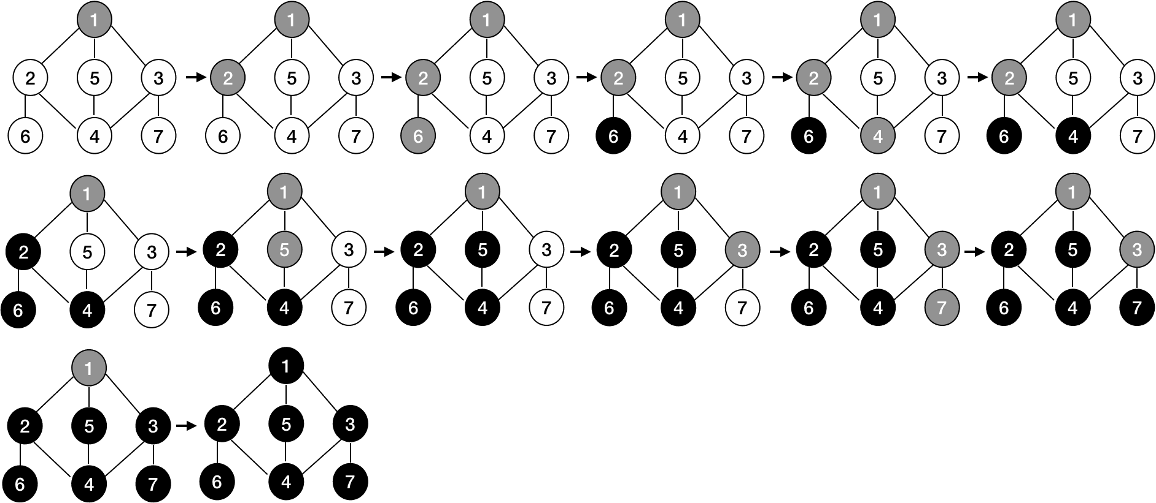
DFS

Slide 42
Illustration of DFS
0
1
2
9
4
10
5
7
11
8
6
Graph G

Slide 43
Applications of DFS and BFS
Using DFS, we can find strongly connected components of a graph. If there is a path from each vertex to every other vertex, that is strongly connected.
In peer-to-peer network like bit-torrent, BFS is used to find all neighbor nodes
Search engine crawlers are used BFS to build index. Starting from source page, it finds all links in it to get new pages
Using GPS navigation system BFS is used to find neighboring places.

Slide 44
Advantages of graphs:
Graphs can be used to model and analyze complex systems and relationships.
They are useful for visualizing and understanding data.
Graph algorithms are widely used in computer science and other fields, such as social network analysis, logistics, and transportation.
Graphs can be used to represent a wide range of data types, including social networks, road networks, and the internet.
Disadvantages of graphs:
Large graphs can be difficult to visualize and analyze.
Graph algorithms can be computationally expensive, especially for large graphs.

Slide 45
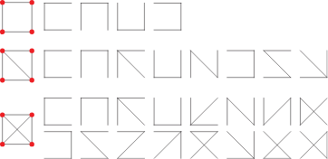
Spanning Tree
A spanning tree of a graph G is a subset of the edges of G that form a tree and include all vertices of G
Let G = (V,E) be an undirected graph. A spanning tree of G is a subset T ⊆ E such that T is a tree on V

Slide 46
Properties of a Spanning Tree:
The number of vertices (V) in the graph and the spanning tree is the same.
There is a fixed number of edges in the spanning tree which is equal to one less than the total number of vertices ( E = V-1 ).
The spanning tree should not be disconnected, as in there should only be a single source of component, not more than that.
The spanning tree should be acyclic, which means there would not be any cycle in the tree.
The total cost (or weight) of the spanning tree is defined as the sum of the edge weights of all the edges of the spanning tree.
There can be many possible spanning trees for a graph.

Slide 47
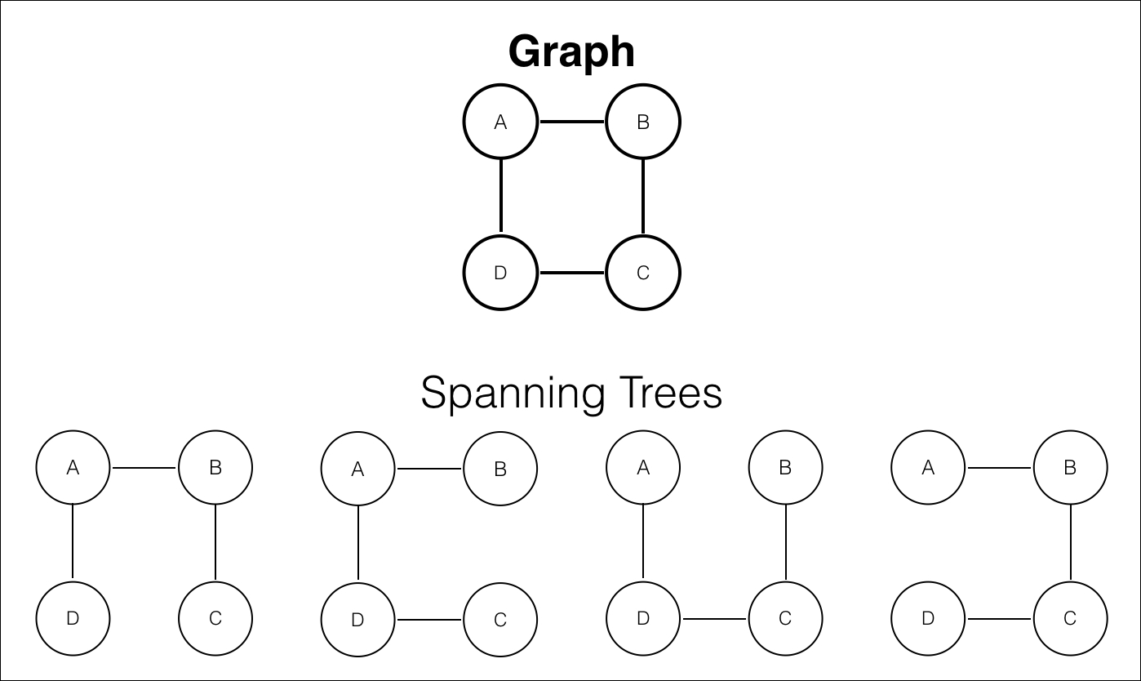
Spanning Tree

Slide 48
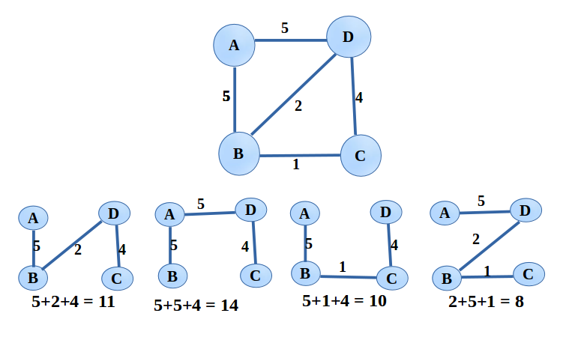
Spanning Tree (weights)

Slide 49
Minimum Spanning Tree
Minimum spanning tree (MST) holds great significance due to its ability to connect various nodes in a network while minimizing the total weight or cost of the connections
Applications: computer networking, transportation systems, and urban planning
Helps in optimizing network efficiency and resource allocation

Slide 50
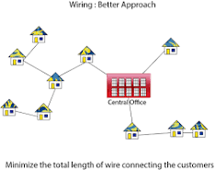
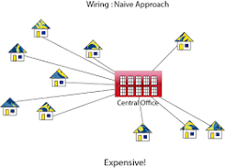

Slide 51
Minimum Spanning Tree
Example: Minimum Spanning Tree in a City’s Road Network Consider a city with several locations and a road network connecting them. To optimize the city’s transportation system, engineers aim to construct a minimum spanning tree of the road network. By employing MST, they identify the most economical routes to connect all locations, avoiding unnecessary detours and congestion-prone paths. The resulting minimum spanning tree represents the backbone of the road network, enabling efficient travel across the city and reducing traffic congestion.

Slide 52
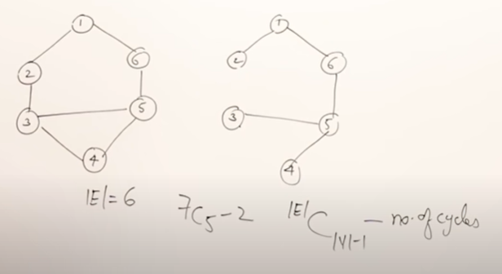
Minimum Cost Spanning Tree
A minimum spanning tree (MST) is defined as a spanning tree that has the minimum weight among all the possible spanning trees
If a graph is a complete graph with n vertices, then total number of spanning trees is n^{(n-2)} where n is the number of nodes in the graph.
For others,

Slide 53
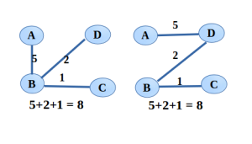
Minimum Spanning Tree
Minimum Spanning Tree

Slide 54
Algorithms to find MST
Kruskal
Prims
Kruskal Example
https://www.geeksforgeeks.org/kruskals-minimum-spanning-tree-algorithm-greedy-algo-2/
Prims Example
https://www.geeksforgeeks.org/prims-minimum-spanning-tree-mst-greedy-algo-5/

Slide 55
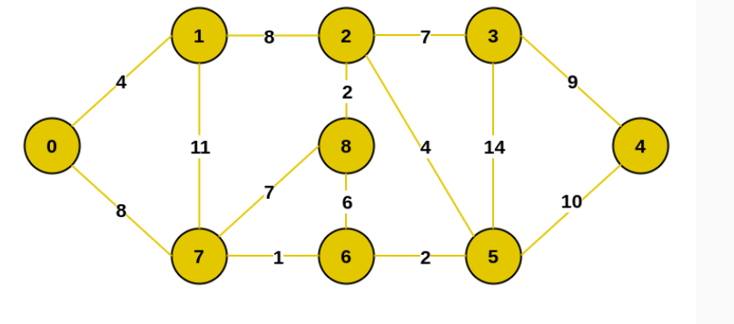
Example
https://www.geeksforgeeks.org/prims-minimum-spanning-tree-mst-greedy-algo-5/

Slide 56
Limitations of MST algorithms
Kruskal’s algorithm and Prim’s algorithm are designed for undirected graphs only.
Prim’s cannot create spanning tree for disconnected graphs.
Kruskal's algorithm may have disconnected graphs.

Slide 57
Applications of Minimum Spanning Trees:
Network design: Spanning trees can be used in network design to find the minimum number of connections required to connect all nodes. Minimum spanning trees, in particular, can help minimize the cost of the connections by selecting the cheapest edges.
Image processing: Spanning trees can be used in image processing to identify regions of similar intensity or color, which can be useful for segmentation and classification tasks.
Biology: Spanning trees and minimum spanning trees can be used in biology to construct phylogenetic trees to represent evolutionary relationships among species or genes.
Social network analysis: Spanning trees and minimum spanning trees can be used in social network analysis to identify important connections and relationships among individuals or groups.

Slide 58
Single Source Shortest Path
Given a graph and a source vertex in the graph, find the shortest paths from the source to all vertices in the given graph.
Two algorithms:
1) Dijkstra
2) Bellman Ford

Slide 59
Dijkstra’s Algorithm
https://www.geeksforgeeks.org/dijkstras-shortest-path-algorithm-greedy-algo-7/
https://www.freecodecamp.org/news/dijkstras-shortest-path-algorithm-visual-introduction/
Updation of the weight of nodes is called relaxation of the nodes.
Can work on both directed and undirected graph.

Slide 60
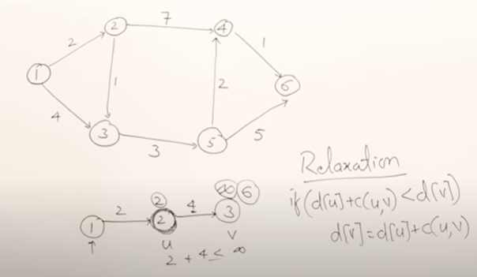
Relaxation of nodes

Slide 61
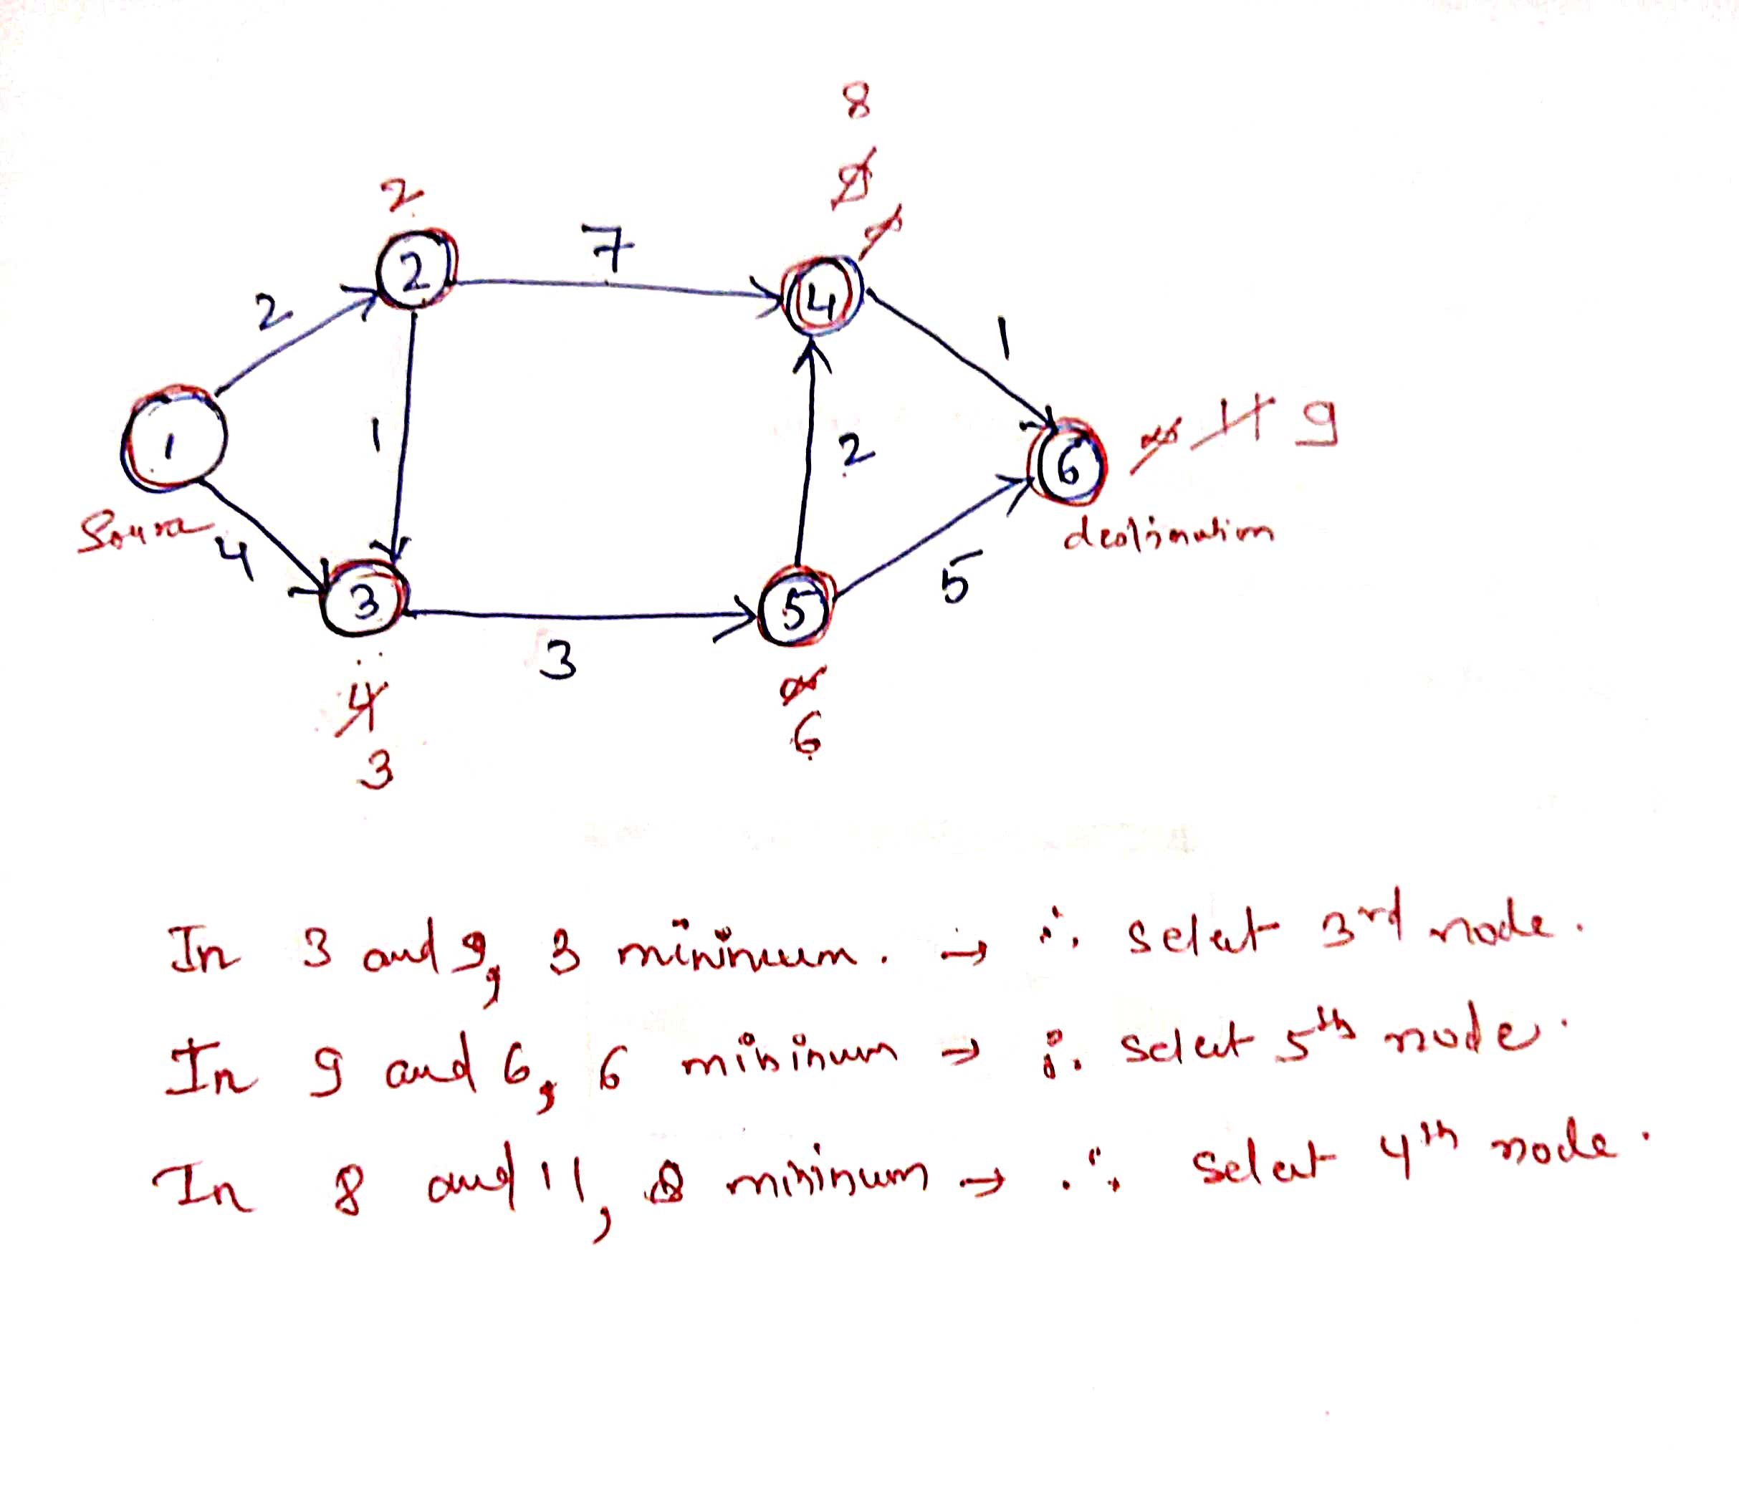

Slide 62
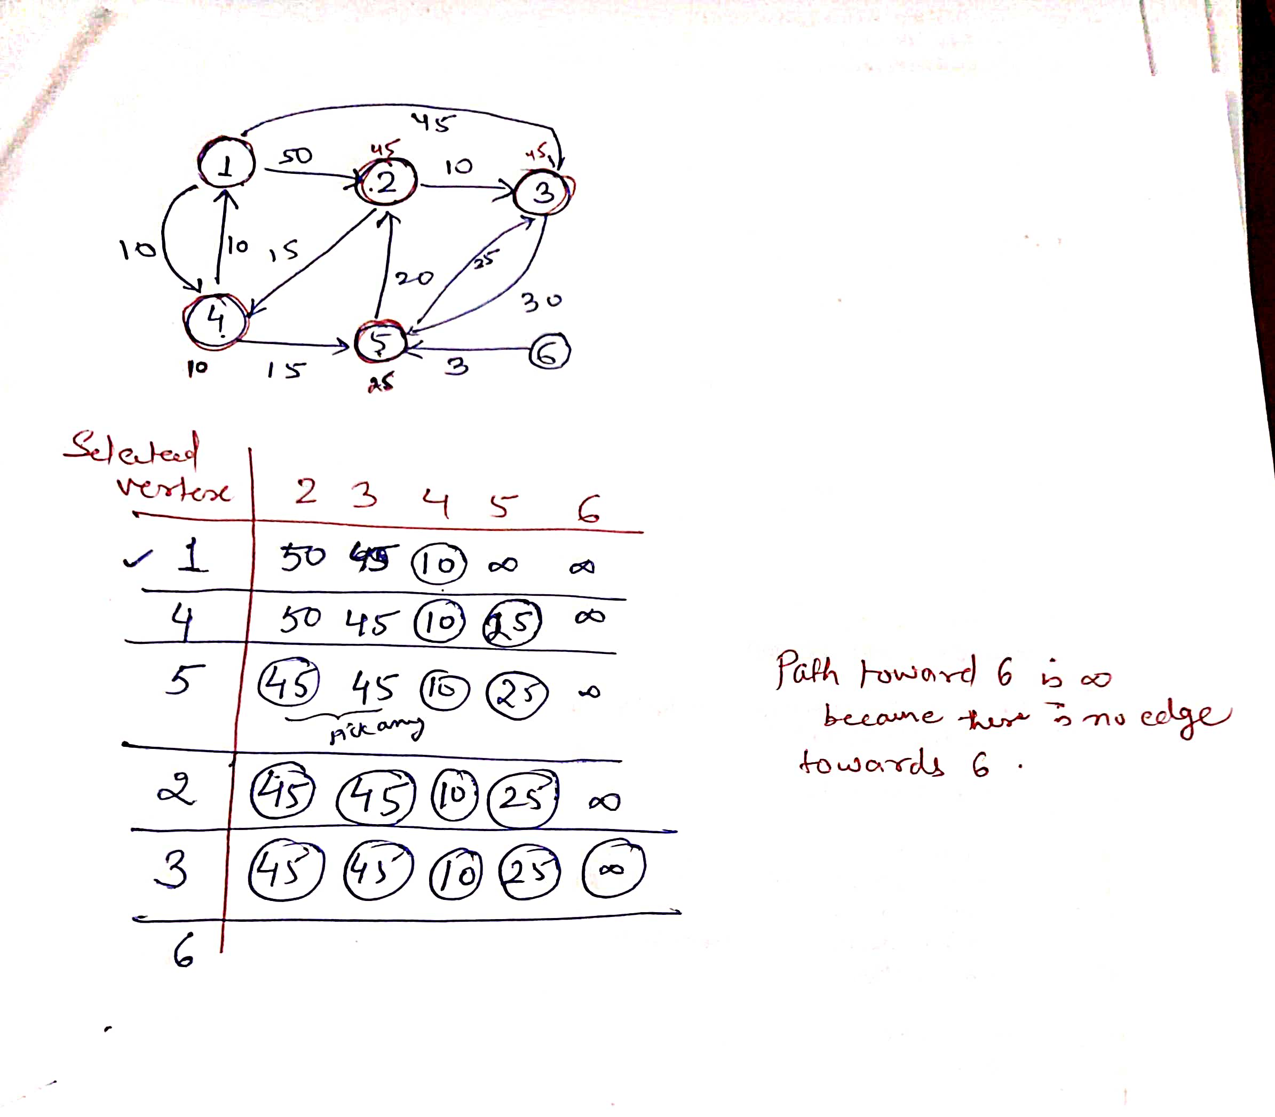

Slide 63
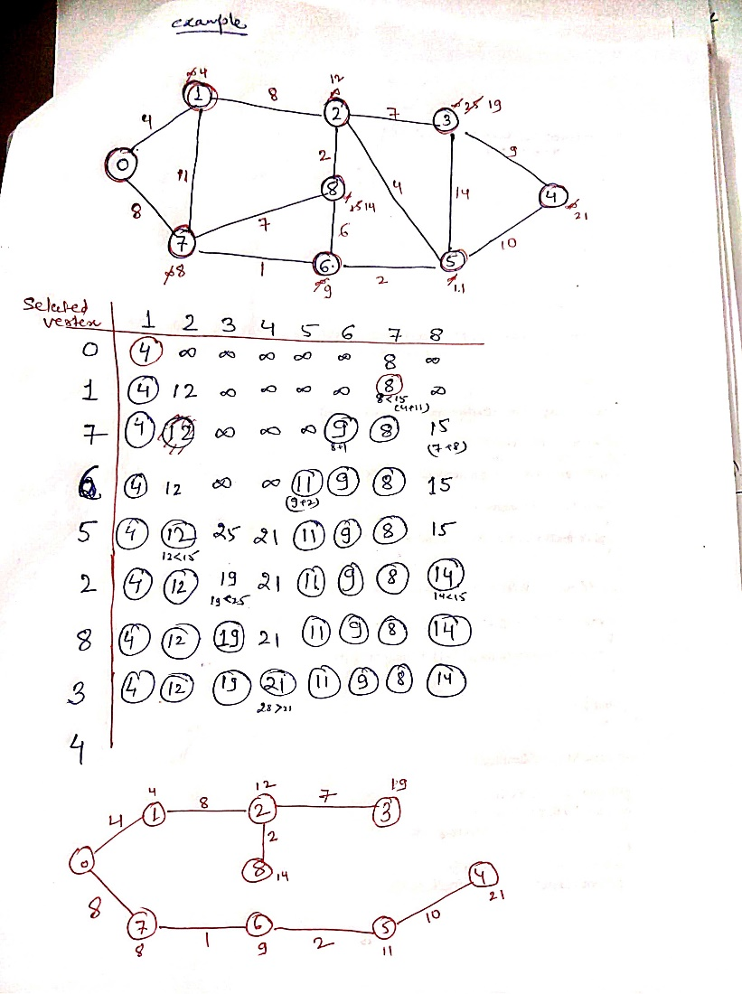

Slide 64
Algorithm
Create a set sptSet (shortest path tree set) that keeps track of vertices included in the shortest path tree, i.e., whose minimum distance from the source is calculated and finalized. Initially, this set is empty.
Assign a distance value to all vertices in the input graph. Initialize all distance values as INFINITE. Assign the distance value as 0 for the source vertex so that it is picked first.
While sptSet doesn’t include all vertices
Pick a vertex u that is not there in sptSet and has a minimum distance value.
Include u to sptSet.
Then update the distance value of all adjacent vertices of u.
To update the distance values, iterate through all adjacent vertices.
For every adjacent vertex v, if the sum of the distance value of u (from source) and weight of edge u-v, is less than the distance value of v, then update the distance value of v.

Slide 65
Time & Space Complexity
Time Complexity: O(V²) Auxiliary Space: O(V)
The time Complexity of the implementation is O(V²). If the input graph is represented using adjacency list, it can be reduced to O(E * log V) with the help of a binary heap.

Slide 66
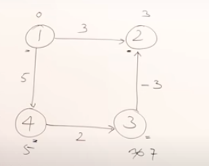
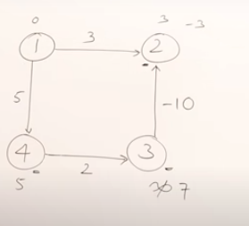
Drawbacks
Dijkstra's Algorithm can only work with graphs that have positive weights. This is because, during the process, the weights of the edges have to be added to find the shortest path.
If there is a negative weight in the graph, then the algorithm may not work properly. Once a node has been marked as "visited", the current path to that node is marked as the shortest path to reach that node. And negative weights can alter this if the total weight can be decremented after this step has occurred.

Slide 67
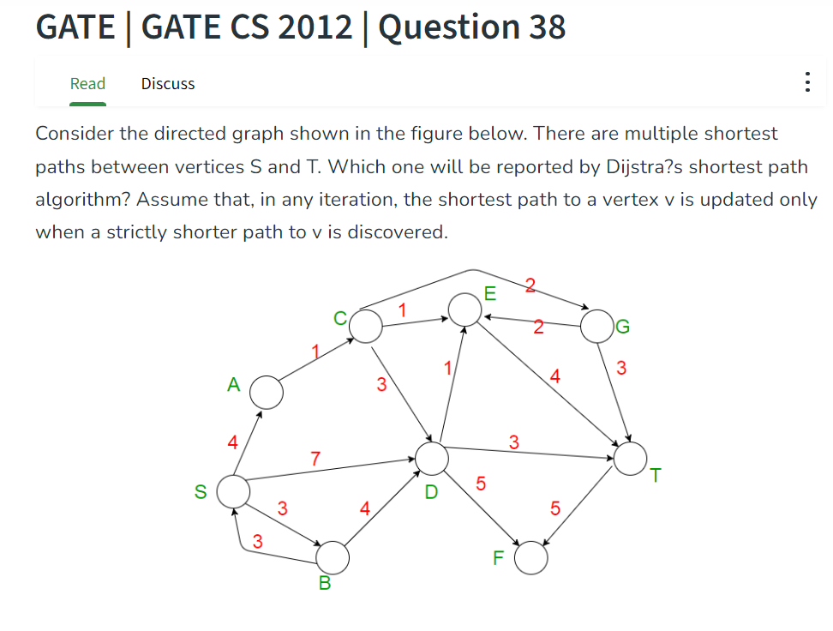
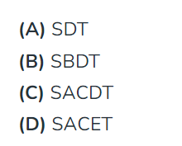
Practice Question
https://www.geeksforgeeks.org/gate-gate-cs-2012-question-40/
Notes:
Ans D

Slide 68
Bellman Ford
The Bellman-Ford algorithm is an example of Dynamic Programming.
Idea is to relax all the edges whether directly connected or not.
All the nodes of the graph should be relaxed V-1 times to get the shortest path.
Some graphs may get shortest path in 1 time relaxation, or 2 times, or 3 times…..V-1, therefore, at most V-1 times relaxation is required to get the shortest path.
Helps to identify negative weight cycle in the graph
Bellman-Ford shortest path algorithm is a single source shortest path algorithm. So it can only find cycles which are reachable from a given source, not any negative weight cycle. Consider a disconnected where a negative weight cycle is not reachable from the source at all.
If there is a negative weight cycle, then it will appear in shortest path as the negative weight cycle will always form a shorter path when iterated through the cycle again and again.

Slide 69
Although Bellman-Ford is slower than Dijkstra’s algorithm, it is capable of handling graphs with negative edge weights, which makes it more versatile. The shortest path cannot be found if there exists a negative cycle in the graph. If we continue to go around the negative cycle an infinite number of times, then the cost of the path will continue to decrease (even though the length of the path is increasing). As a result, Bellman-Ford is also capable of detecting negative cycles, which is an important feature.
The idea behind Bellman Ford Algorithm:
The Bellman-Ford algorithm’s primary principle is that it starts with a single source and calculates the distance to each node. The distance is initially unknown and assumed to be infinite, but as time goes on, the algorithm relaxes those paths by identifying a few shorter paths. Hence it is said that Bellman-Ford is based on “Principle of Relaxation“.

Slide 70
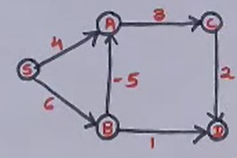
Notes:
01646 Ans

Slide 71
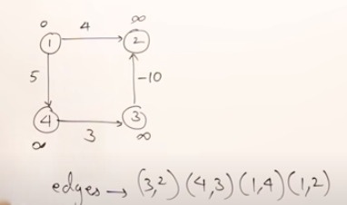
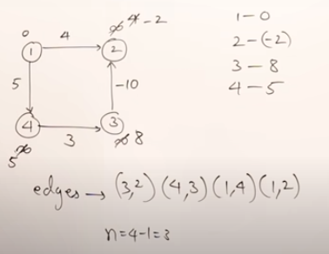
Example

Slide 72
Time and Space Complexity Analysis
Time complexity of Bellman-Ford is O(VE), which is more than Dijkstra. where V is a number of vertices and E is a number of edges. For a complete graph with n vertices, V = n, E = O(n²). So overall time complexity becomes O(n³).
For complete graph E=(n(n-1))/2, where n is number of vertices
Best Case: O(E), when distance array after 1st and 2nd relaxation are same , we can simply stop further processing.
Average Case: O(V*E)
Worst Case: O(V*E)
Auxiliary Space: O(V), where V is the number of vertices in the graph.

Slide 73
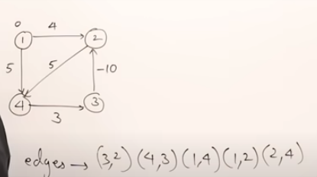
Drawback
Will not give correct result if negative weight cycle is present in the graph.

Slide 74
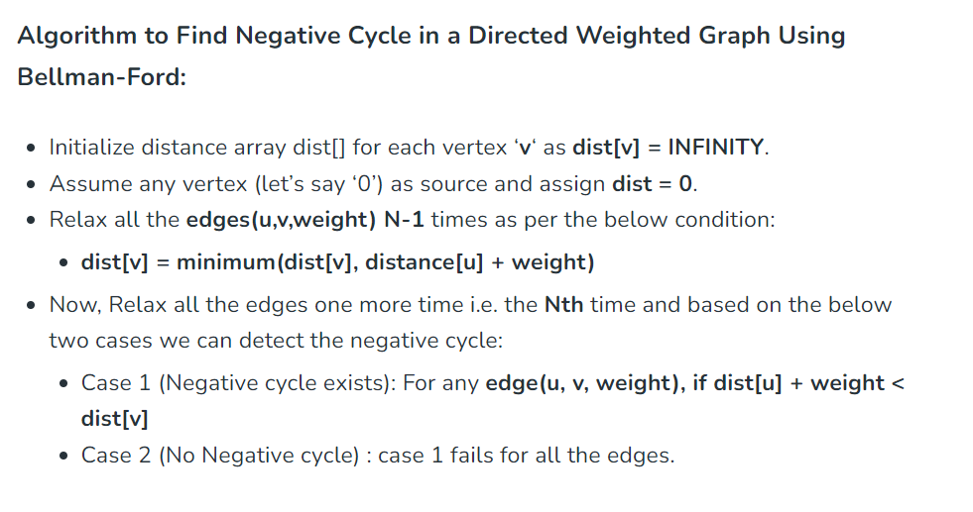
Bellman ford to detect negative weight cycle in the graph
https://www.geeksforgeeks.org/bellman-ford-algorithm-dp-23/

Slide 75
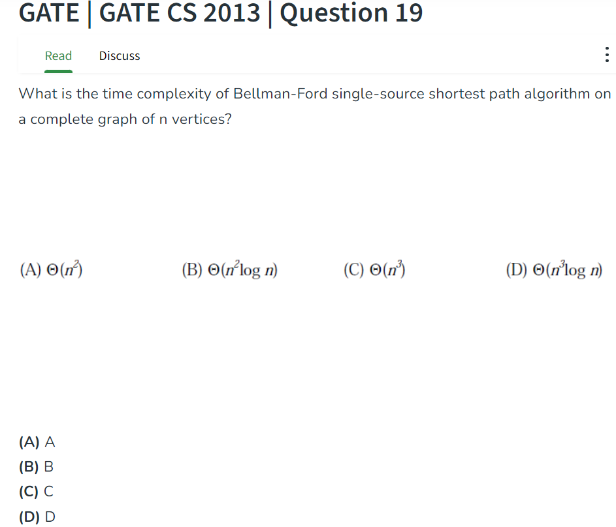
Notes:
Ans C

Slide 76
Difference between Bellman Ford and Dijkstra Algorithms
Bellman Ford’s Algorithm | Dijkstra’s Algorithm
Bellman Ford’s Algorithm works when there is negative weight edge, it also detects the negative weight cycle. | Dijkstra’s Algorithm may or may not work when there is negative weight edge. But will definitely not work when there is a negative weight cycle.
The result contains the vertices which contains the information about the other vertices they are connected to. | The result contains the vertices containing whole information about the network, not only the vertices they are connected to.
It can easily be implemented in a distributed way. | It can not be implemented easily in a distributed way.
It is more time consuming than Dijkstra’s algorithm. Its time complexity is O(VE). | It is less time consuming. The time complexity is O(E logV).
Dynamic Programming approach is taken to implement the algorithm. | Greedy approach is taken to implement the algorithm.
Bellman Ford’s Algorithm have more overheads than Dijkstra’s Algorithm. | Dijkstra’s Algorithm have less overheads than Bellman Ford’s Algorithm.
Bellman Ford’s Algorithm have less scalability than Dijkstra’s Algorithm. | Dijkstra’s Algorithm have more scalability than Bellman Ford’s Algorithm. .

Slide 77
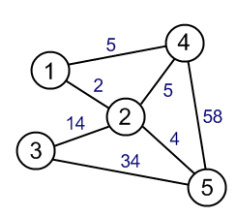
Difference between MSTs and Shortest Path Algorithms
So we’ve seen the various Minimum Spanning Trees Algorithms and the Shortest Path Algorithms till now. Both focus on minimizing the weights of the edges. But the outcomes are different. MSTs give Trees as Outputs whereas, in Shortest Path Algorithms, it actually gives us a path we could traverse in the Graph, with minimum Weight/ Cost.
Let’s clear it up by taking an example-

Slide 78
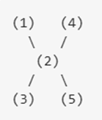
The spanning-tree looks like below. This is because if we add up the edges in this configuration, we get the least total cost possible: 2+5+14+4=25.
By just seeing the Graph, we might be thinking that this MST gives us the shortest path, but it doesn’t. If we want to go from 1 to 4, the cost would be 7, whereas it’s just 5, using Dijkstra’s Algorithm. This proves that MSTs and Shortest Path problems are different and should not be confused with each other.

Slide 79
https://www.geeksforgeeks.org/difference-between-minimum-spanning-tree-and-shortest-path/
Minimum spanning tree(MST) | The Shortest path
In MST there is no source and no destination, but it is the subset (tree) of the graph(G) which connects all the vertices of the graph G without any cycles and the minimum possible total edge weight. | There is a source and destination, and one need to find out the shortest path between them
Graph (G) should be connected, undirected, edge-weighted, labeled. | It is not necessary for the Graph (G) to be connected, undirected, edge-weighted, labeled.
Here relaxation of edges is not performed but here the minimum edge weight is chosen one by one from the set of all edge weights (sorted according to min weight) and the tree is formed by them (i.e. there should not be any cycle). | Here the relaxation of edges is performed. Here d(U) means the distance of source vertex S to vertex where C(U, V) is the distance between U and V. If d(U) > d(V) + C(U, V) then d(U) = d(V) + C(U, V). For example, 20>10+5, d(U) = 15, is the minimum distance from source vertex S to vertex U. Therefore, relaxation is performed.
In this case, a minimum spanning tree can be formed but negative weights edge cycles are not generally used. Using the cycle property of MST, the minimum edge weight among all the edge weights in the negative edge cycle can be selected. | If the graph is connected, and if a negative weight edge cycle present in the graph. Then the shortest path can not be computed, but the negative edge cycle can be detected using the Bellman-Ford algorithm.
In the case of a disconnected graph, the minimum spanning tree can not be formed but many spanning-tree forests can be formed. | In the case of a disconnected graph, the distance between two vertices present in two different components is infinity.
Here the Greedy approach is used for finding MST for a graph, For example, Prim’s algorithm and Kruskal’s algorithm. | The Dijkstra algorithm based on the Greedy approach and Bellman ford based on Dynamic programming are generally used for finding the single-source shortest paths. Floyd-War shall algorithm based on the Dynamic programming is used for finding all pairs the shortest path.
If there are N vertices are present inside graph G then the minimum spanning tree of the graph will contain N-1 edges and N vertices. | If there are N vertices present inside graph G, then in the shortest path between two vertices there can be at most N-1 edges, and at most N vertices can be present in the shortest path.
It is used in network design (computer networks, telecommunication networks, water supply networks) and in circuit design applications, and many more. | It is used to find out direction between physical locations like in Google Map

